Slide 1
INTRODUCTION TO EMBEDDED C PROGRAMMING

Slide 2
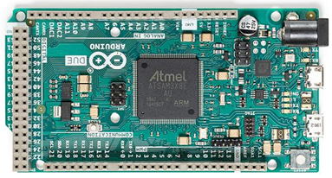
Arduino DUE
The Arduino Due is a microcontroller board based on the Atmel SAM3X8E ARM Cortex-M3 CPU.
It is the first Arduino board based on a 32-bit ARM core microcontroller.

Slide 3
Some of ARM Core Benefits are
  A 32-bit core, that allows operations on 4 bytes wide data within a single CPU clock at 84MHz.
  96 KBytes of SRAM.
  512 KBytes of Flash memory for code.
  A DMA controller that can relieve the CPU from doing memory intensive tasks

Slide 4
It has 54 digital input/output pins of which
  12 can be used as PWM(Pulse width modulation) outputs
  12 analog inputs
  4 UARTs(universal asynchronous receiver-transmitter) (hardware serial ports)
  a 84 MHz clock
  an USB OTG capable connection
  2 DAC (digital to analog)
  2 TWI, a power jack
  an SPI header
  a JTAG header
  a reset button and an erase button.
The board contains everything needed to support the microcontroller; simply connect it to a computer with a micro-USB cable or power it with an AC-to-DC adapter or battery to get started.

Slide 5
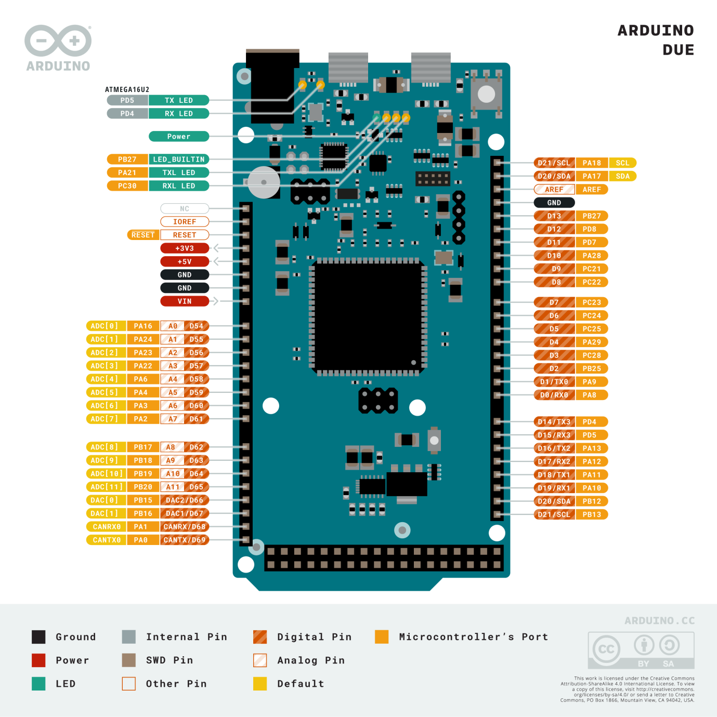

Slide 6
Power
The Arduino Due can be powered via the USB connector or with an external power supply. The power source is selected automatically.
External (non-USB) power can come either from an AC-to-DC adapter or battery.
The adapter can be connected by plugging a 2.1mm center-positive plug into the board's power jack.
Leads from a battery can be inserted in the GND and Vin pin headers of the POWER connector.
The board can operate on an external supply of 6 to 20 volts.

Slide 7
The power pins are as follows:
  Vin: You can supply voltage through this pin, or if supplying voltage via the power jack, access it through this pin.
  5V: This pin outputs a regulated 5V from the regulator on the board.
  3V3: A 3.3 volt supply generated by the on-board regulator. Maximum current draw is 800 mA. This regulator also provides the power supply to the SAM3X microcontroller.
  GND: Ground pins.
  IOREF: This pin on the Arduino board provides the voltage reference with which the microcontroller operates. A properly configured shield can read the IOREF pin voltage and select the appropriate power source or enable voltage translators on the outputs for working with the 5V or 3.3V.

Slide 8
Memory
The SAM3X has 512 KB (2 blocks of 256 KB) of flash memory for storing code.
The bootloader is pre burned in factory from Atmel and is stored in a dedicated ROM memory.
The available SRAM is 96 KB in two contiguous bank of 64 KB and 32 KB. All the available memory (Flash, RAM and ROM) can be accessed directly as a flat addressing space.
It is possible to erase the Flash memory of the SAM3X with the onboard erase button. This will remove the currently loaded sketch from the MCU.
To erase, press and hold the Erase button for a few seconds while the board is powered.

Slide 9
Input and Output
Digital I/O:
Total of 54 pins from 0 to 53 are available on the board. Each of the 54 digital pins on the Due can be used as an input or output, using pinMode(), digitalWrite(), and digitalRead() functions.
They operate at 3.3 volts. Each pin can provide (source) a current of 3 mA or 15 mA, depending on the pin, or receive (sink) a current of 6 mA or 9 mA, depending on the pin.
They also have an internal pull-up resistor (disconnected by default) of 100 KOhm.

Slide 10
In addition, some pins have specialized functions:
  There are 4 serial ports which are used to receive (RX) and transmit (TX) TTL serial data.
    Serial(0-RX, 1-TX), Serial1(19-RX, 20-TX), Serial2(17-RX, 18-TX) and Serial3(15-RX, 16-TX).
  Pins 2 to 13 provide 8-bit PWM output with the analogWrite() function. The resolution of the PWM can be changed with the analogWriteResolution() function.
  The board support SPI communication using the SPI library. The SPI pins are broken out on the central 6-pin header, which is physically compatible with the Uno, Leonardo and Mega2560. The SPI header can be used only to communicate with other SPI devices, not for programming the SAM3X with the In-Circuit-Serial-Programming technique. The SPI of the Due has also advanced features that can be used with the Extended SPI methods for Due.

Slide 11
CANRX and CANTX pins support the CAN(Controller Area Network) communication protocol but are not yet supported by Arduino APIs.
There is a built-in LED connected to digital pin 13.
  When the pin is HIGH, the LED is on, when the pin is LOW, it's off. It is also possible to dim the LED because the digital pin 13 is also a PWM output.
Arduino Due also supports TWI communication using the Wire library. Board has 2 TWI communication pins.
  In which TWI 1(20-SDA, 21-SCL) which has internal pull-up registers and TWI 2(SDA1, SCL1) doesn’t have internal pull-up register.

Slide 12
Analog Pins:
  The Due has 12 analog inputs (pins from A0 to A11), each of which can provide 12 bits of resolution (i.e., 4096 different values).
  By default, the resolution of the readings is set at 10 bits, for compatibility with other Arduino boards. It is possible to change the resolution of the ADC with analogReadResolution().
  The Due’s analog inputs pins measure from ground to a maximum value of 3.3V.
DAC1 and DAC2:
  These pins provides true analog outputs with 12-bits resolution (4096 levels) with the analogWrite() function.
  These pins can be used to create an audio output using the Audio library.
  Please note that DAC output range is actually from 0.55 V to 2.75 V only.

Slide 13
Other pins on the board:
  AREF: Reference voltage for the analog inputs. Used with analogReference().
  Reset: Bring this line LOW to reset the microcontroller. Typically used to add a reset button to shields which block the one on the board.

Slide 14
Communication
The Arduino Due has a number of facilities for communicating with a computer, another Arduino or other microcontrollers, and different devices like phones, tablets, and cameras and so on.
The SAM3X provides one hardware UART and three hardware USARTs for TTL (3.3V) serial communication.
The Programming port is connected to an ATmega16U2, which provides a virtual COM port to software on a connected computer.
The 16U2 is also connected to the SAM3X hardware UART.
Serial on pins RX0 and TX0 provides Serial-to-USB communication for programming the board through the ATmega16U2 microcontroller.
The Arduino software includes a serial monitor which allows simple textual data to be sent to and from the board.

Slide 15
The RX and TX LEDs on the board will flash when data is being transmitted via the ATmega16U2 chip and USB connection to the computer.
  To use this port, select "Arduino Due (ProgrammingPort)" as your board in the Arduino IDE.
The Native USB port is connected to the SAM3X, which allows for serial (CDC) communication over USB.
This provides a serial connection to the Serial Monitor or other applications on your computer.
It also enables the Due to emulate a USB mouse or keyboard to an attached computer. To use these features, see the Mouse and Keyboard library reference pages. To use this port, select "Arduino Due (NativeUSBPort)" as your board in the Arduino IDE.

Slide 16
USB Overcurrent Protection
The Arduino Due has a resettable polyfuse that protects your computer's USB ports from shorts and overcurrent.
Although most computers provide their own internal protection, the fuse provides an extra layer of protection.
If more than 500 mA is applied to the USB port, the fuse will automatically break the connection until the short or overload is removed.

Slide 17
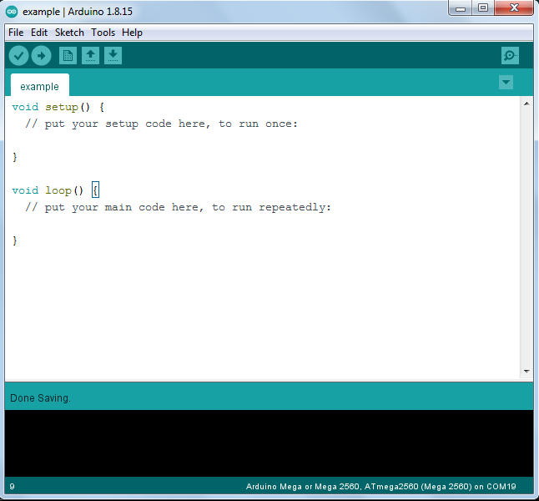
Arduino IDE software:

Slide 18
The Arduino Integrated Development Environment (IDE) is a cross-platform application that is written in functions from C and C++. Arduino IDE is a open-source software, designed by Arduino.cc and mainly used for writing, compiling & uploading code to almost all Arduino Modules. It is an official Arduino software, making code compilation too easy that even a common person with no prior technical knowledge can get their feet wet with the learning process.
It is available for all operating systems i.e. MAC, Windows, Linux and runs on the Java Platform that comes with inbuilt functions and commands that play a vital role in debugging, editing and compiling the code. A range of Arduino modules available including Arduino Uno, Arduino Mega, Arduino Leonardo, Arduino Micro, Arduino DUE and many more. In laboratory we are using Arduino Due. Each of them contains a microcontroller on the board that is actually programmed and accepts the information in the form of code.

Slide 19
The main code, also known as a sketch, created on the IDE platform will ultimately generate a Hex File which is then transferred and uploaded in the controller on the board.
The IDE environment mainly contains two basic parts: Editor and Compiler where former is used for writing the required code and later is used for compiling and uploading the code into the given Arduino Module.
More or less, Arduino C language works similar to the regular C language used for any embedded system microcontroller, however, there are some dedicated libraries used for calling and executing specific functions on the board.

Slide 20
How to get Arduino IDE:
We can download the software from Arduino main website.
  https://www.arduino.cc/en/software
The software is available for common operating systems like Linux, Windows, and MAC, we select to download the correct software version that is easily compatible with our operating system.

Slide 21
The IDE environment is mainly distributed into three sections
1.Menu Bar
The bar appearing on the top is called Menu Bar that comes with five different options as follow
File - You can open a new window for writing the code or open an existing one. It also contains some predefined examples.
Edit - You can undo/redo, cut, copy, paste, select all, comment/uncomment and also you can find highlights of next and previous occurrences.
Sketch - You can verify/compile the sketch, you can upload the program to the kit and also you can include libraries.
Tools - You can Auto format the sketch which gives you correct indents. You can also open serial monitor to see the results. You must select the board, COM port and programmer before uploading.

Slide 22
Help - Find in reference is the only function in help menu: it directly selects the relevant pages in the local copy of the reference for the function or command under cursor.
The Six Buttons appearing under the Menu tab are connected with the running program as follows.
  The checkmark appearing in the circular button is used to verify the code. Click this once you have written your code.
  The arrow key will upload and transfer the required code to the Arduino board.
  The dotted paper is used for creating a new file.
  The upward arrow is reserved for opening an existing Arduino project.
  The downward arrow is used to save the current running code.
  The button appearing on the top right corner is a Serial Monitor.

Slide 23
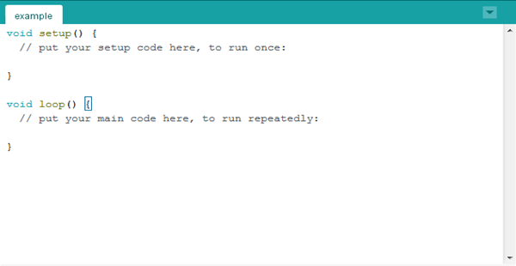
2. Text Editor
The design code is written in the text editor. As you can see the text editor contains two loops such as void setup and void loop.
The code written in void setup will run exactly one time. But the code written in loop will run continuously.

Slide 24

3.Output Pane
The bottom of the main screen is described as an Output Pane that mainly highlights the compilation status of the running code: the memory used by the code, and errors that occurred in the program.
You need to fix those errors before you intend to upload the hex file into your Arduino Module.

Slide 25
Arduino Overview
Arduino is a prototype platform (open-source) based on an easy-to-use hardware and software.
It consists of a circuit board, which can be programed (referred to as a microcontroller) and a ready-made software called Arduino IDE (Integrated Development Environment), which is used to write and upload the computer code to the physical board.

Slide 26
The key features are −
  Arduino boards are able to read analog or digital input signals from different sensors and turn it into an output such as activating a motor, turning LED on/off, connect to the cloud and many other actions.
  You can control your board functions by sending a set of instructions to the microcontroller on the board via Arduino IDE (referred to as uploading software).
  Unlike most previous programmable circuit boards, Arduino does not need an extra piece of hardware (called a programmer) in order to load a new code onto the board. You can simply use a USB cable.
  Additionally, the Arduino IDE uses a simplified version of C++, making it easier to learn to program.
  Finally, Arduino provides a standard form factor that breaks the functions of the micro-controller into a more accessible package.

Slide 27
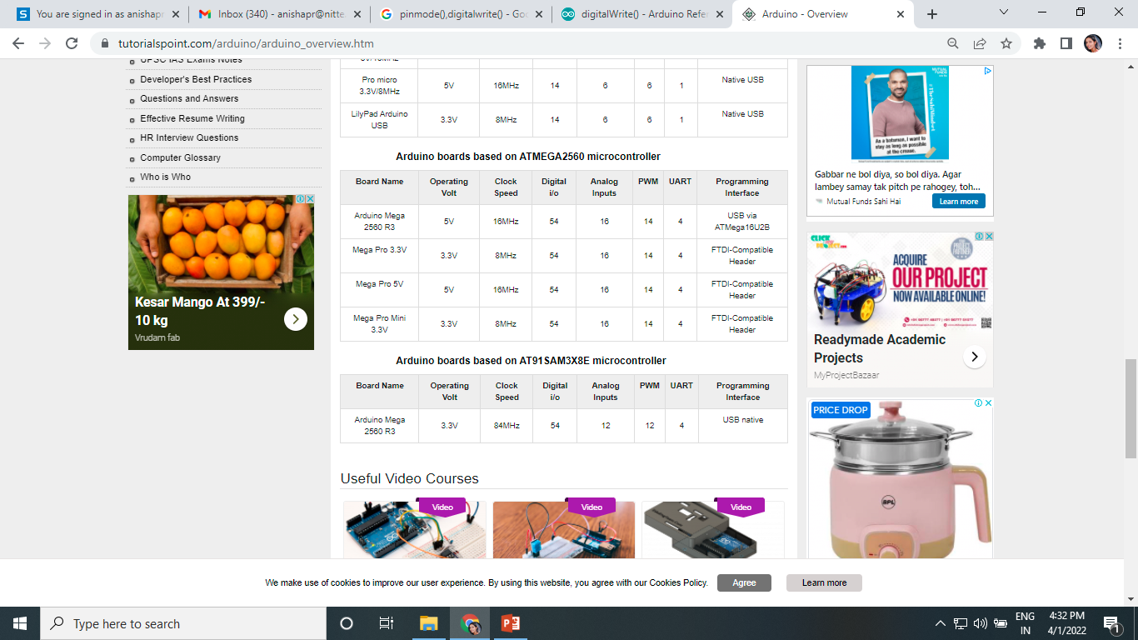
Board Types
Various kinds of Arduino boards are available depending on different microcontrollers used. However, all Arduino boards have one thing in common: they are programed through the Arduino IDE.
The differences are based on the number of inputs and outputs (the number of sensors, LEDs, and buttons you can use on a single board), speed, operating voltage, form factor etc. Some boards are designed to be embedded and have no programming interface (hardware), which you would need to buy separately. Some can run directly from a 3.7V battery, others need at least 5V.

Slide 28
Program Structure
Arduino programs can be divided in three main parts: Structure, Values (variables and constants), and Functions.
Structure.
Software structure consist of two main functions −
  Setup( ) function
  Loop( ) function

Slide 29
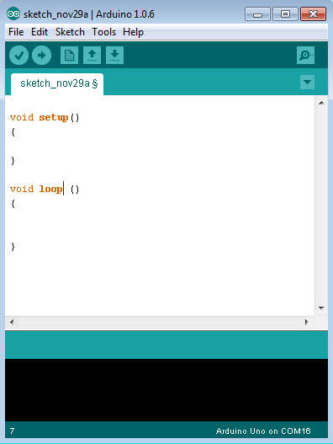

Slide 30
Void setup ( ) {
}
PURPOSE −
The setup() function is called when a sketch starts. Use it to initialize the variables, pin modes, start using libraries, etc.
The setup function will only run once, after each power up or reset of the Arduino board.

Slide 31
Void Loop ( ) {
}
PURPOSE −
After creating a setup() function, which initializes and sets the initial values, the loop() function does precisely what its name suggests, and loops consecutively, allowing your program to change and respond.
Use it to actively control the Arduino board.

Slide 32
Arduino - I/O Functions
The pins on the Arduino board can be configured as either inputs or outputs.
It is important to note that a majority of Arduino analog pins, may be configured, and used, in exactly the same manner as digital pins.

Slide 33
Pins Configured as INPUT
Arduino pins are by default configured as inputs, so they do not need to be explicitly declared as inputs with pinMode() when you are using them as inputs. Pins configured this way are said to be in a high-impedance state. Input pins make extremely small demands on the circuit that they are sampling, equivalent to a series resistor of 100 megaohm in front of the pin.
This means that it takes very little current to switch the input pin from one state to another. This makes the pins useful for such tasks as implementing a capacitive touch sensor or reading an LED as a photodiode.
Pins configured as pinMode(pin, INPUT) with nothing connected to them, or with wires connected to them that are not connected to other circuits, report seemingly random changes in pin state, picking up electrical noise from the environment, or capacitively coupling the state of a nearby pin.

Slide 34
Pull-up Resistors
Pull-up resistors are often useful to steer an input pin to a known state if no input is present.
This can be done by adding a pull-up resistor (to +5V), or a pull-down resistor (resistor to ground) on the input.
A 10K resistor is a good value for a pull-up or pull-down resistor.

Slide 35
Using Built-in Pull-up Resistor with Pins Configured as Input
There are 20,000 pull-up resistors built into the Atmega chip that can be accessed from software. These built-in pull-up resistors are accessed by setting the pinMode() as INPUT_PULLUP. This effectively inverts the behavior of the INPUT mode, where HIGH means the sensor is OFF and LOW means the sensor is ON. The value of this pull-up depends on the microcontroller used. On most AVR-based boards, the value is guaranteed to be between 20kΩ and 50kΩ. On the Arduino Due, it is between 50kΩ and 150kΩ. For the exact value, consult the datasheet of the microcontroller on your board.
When connecting a sensor to a pin configured with INPUT_PULLUP, the other end should be connected to the ground. In case of a simple switch, this causes the pin to read HIGH when the switch is open and LOW when the switch is pressed. The pull-up resistors provide enough current to light an LED dimly connected to a pin configured as an input. If LEDs in a project seem to be working, but very dimly, this is likely what is going on.

Slide 36
Same registers (internal chip memory locations) that control whether a pin is HIGH or LOW control the pull-up resistors. Consequently, a pin that is configured to have pull-up resistors turned on when the pin is in INPUTmode, will have the pin configured as HIGH if the pin is then switched to an OUTPUT mode with pinMode(). This works in the other direction as well, and an output pin that is left in a HIGH state will have the pull-up resistor set if switched to an input with pinMode().
Example:
    pinMode(3,INPUT) ; // set pin to input without using built in pull up resistor
    pinMode(5,INPUT_PULLUP) ; // set pin to input using built in pull up resistor

Slide 37
Pins Configured as OUTPUT
Pins configured as OUTPUT with pinMode() are said to be in a low-impedance state. This means that they can provide a substantial amount of current to other circuits. Atmega pins can source (provide positive current) or sink (provide negative current) up to 40 mA (milliamps) of current to other devices/circuits. This is enough current to brightly light up an LED (do not forget the series resistor), or run many sensors but not enough current to run relays, solenoids, or motors.
Attempting to run high current devices from the output pins, can damage or destroy the output transistors in the pin, or damage the entire Atmega chip. Often, this results in a "dead" pin in the microcontroller but the remaining chips still function adequately. For this reason, it is a good idea to connect the OUTPUT pins to other devices through 470Ω or 1k resistors, unless maximum current drawn from the pins is required for a particular application.

Slide 38
pinMode() Function
The pinMode() function is used to configure a specific pin to behave either as an input or an output. It is possible to enable the internal pull-up resistors with the mode INPUT_PULLUP. Additionally, the INPUT mode explicitly disables the internal pull-ups.
pinMode() Function Syntax:
Void setup () {
pinMode (pin , mode);
}
pin − the number of the pin whose mode you wish to set
mode − INPUT, OUTPUT, or INPUT_PULLUP.

Slide 39
Example:
int button = 5 ; // button connected to pin 5
int LED = 6; // LED connected to pin 6
void setup () {
pinMode(button , INPUT_PULLUP);
// set the digital pin as input with pull-up resistor
pinMode(button , OUTPUT); // set the digital pin as output
}
void setup () {
If (digitalRead(button ) == LOW) // if button pressed {
digitalWrite(LED,HIGH); // turn on led
delay(500); // delay for 500 ms
digitalWrite(LED,LOW); // turn off led
delay(500); // delay for 500 ms
}
}

Slide 40
digitalWrite() Function
The digitalWrite() function is used to write a HIGH or a LOW value to a digital pin. If the pin has been configured as an OUTPUT with pinMode(), its voltage will be set to the corresponding value: 5V (or 3.3V on 3.3V boards) for HIGH, 0V (ground) for LOW. If the pin is configured as an INPUT, digitalWrite() will enable (HIGH) or disable (LOW) the internal pullup on the input pin. It is recommended to set the pinMode() to INPUT_PULLUP to enable the internal pull-up resistor.
If you do not set the pinMode() to OUTPUT, and connect an LED to a pin, when calling digitalWrite(HIGH), the LED may appear dim. Without explicitly setting pinMode(), digitalWrite() will have enabled the internal pull-up resistor, which acts like a large current-limiting resistor.
digitalWrite() Function Syntax:
Void loop() {
digitalWrite (pin ,value);
}
  pin − the number of the pin whose mode you wish to set
  value − HIGH, or LOW.

Slide 41
Example:
int LED = 6; // LED connected to pin 6
void setup () {
pinMode(LED, OUTPUT); // set the digital pin as output
}
void loop () {
digitalWrite(LED,HIGH); // turn on led
delay(500); // delay for 500 ms
digitalWrite(LED,LOW); // turn off led
delay(500); // delay for 500 ms
}

Slide 42
analogRead( ) function
Arduino is able to detect whether there is a voltage applied to one of its pins and report it through the digitalRead() function. There is a difference between an on/off sensor (which detects the presence of an object) and an analog sensor, whose value continuously changes. In order to read this type of sensor, we need a different type of pin.
In the lower-right part of the Arduino board, you will see six pins marked “Analog In”. These special pins not only tell whether there is a voltage applied to them, but also its value. By using the analogRead() function, we can read the voltage applied to one of the pins.
This function returns a number between 0 and 1023, which represents voltages between 0 and 5 volts. For example, if there is a voltage of 2.5 V applied to pin number 0, analogRead(0) returns 512.

Slide 43
analogRead() function Syntax:
analogRead(pin);
  pin − the number of the analog input pin to read from (0 to 5 on most boards, 0 to 7 on the Mini and Nano, 0 to 15 on the Mega)
Example
int analogPin = 3;//potentiometer wiper (middle terminal)
// connected to analog pin 3
int val = 0; // variable to store the value read
void setup() {
Serial.begin(9600); // setup serial
}
void loop() {
val = analogRead(analogPin); // read the input pin
Serial.println(val); // debug value
}

Slide 44
First HELLO LED! Program
LEDs are small, powerful lights that are used in many different applications.
To start, we will work on blinking an LED, the Hello World of microcontrollers.
It is as simple as turning a light on and off.
Establishing this important baseline will give you a solid foundation as we work towards experiments that are more complex.
Blink250ms Program
  Turns a LED connected to digital pin 8 on for 250ms, then off for 1s(1000ms), infinitely.

Slide 45
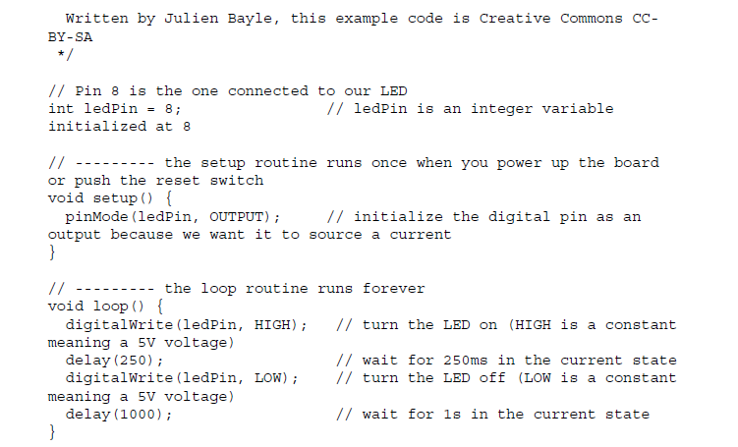

Slide 46
Let's write the code
Comments
First, everything between /* and */, and everything after // are just comments.
The first form is used for comments more than one line at a time, and the other one is for one line commenting only.
You can write any comments like that and they won't be considered by the compiler at all.

Slide 47
Then, the first part of the code contains one variable declaration and initialization:
int ledPin = 8;

Slide 48
Then, we can see two particular structures between curly braces:
void setup() {
pinMode(ledPin, OUTPUT);
}
void loop() {
digitalWrite(ledPin, HIGH);
delay(250);
digitalWrite(ledPin, LOW);
delay(1000);
}

Slide 49
The first one (setup()) is a function that is executed only one time when the Arduino board is started (or reseted); this is the place where we are telling the board that the pin where the LED is connected is an output, that is, this pin will have to drive current while activated.
The second one (loop()) is a function executed infinitely when the Arduino board is supplied. This is the main part of our code in which we can find the steps we wanted to light up the LED for 250 ms and switch off the LED for 1 s, repeatedly.

Slide 50
If you want to tweak the code a bit, you can replace the following line:
delay(1000);
With the following line, for instance:
delay(100);

Slide 51
pinMode(ledPin, OUTPUT)
  Before you can use one of Arduino’s pins, you need to tell Arduino Uno R3 whether it is an INPUT or OUTPUT. We use a built-in “function” called pinMode() to do this.
digitalWrite(ledPin, HIGH)
  When you are using a pin as an OUTPUT, you can command it to be HIGH (output 5 volts), or LOW (output 0 volts).

Slide 52
Arduino - Communication
Hundreds of communication protocols have been defined to achieve this data exchange.
Each protocol can be categorized into one of the two categories: parallel or serial.

Slide 53
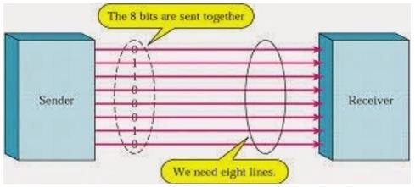
Parallel Communication
Parallel connection between the Arduino and peripherals via input/output ports is the ideal solution for shorter distances up to several meters.
However, in other cases when it is necessary to establish communication between two devices for longer distances it is not possible to use parallel connection.
Parallel interfaces transfer multiple bits at the same time.
They usually require buses of data - transmitting across eight, sixteen, or more wires. Data is transferred in huge, crashing waves of 1’s and 0’s.

Slide 54
Advantages and Drawbacks of Parallel Communication
Parallel communication certainly has its advantages. It is faster than serial, straightforward, and relatively easy to implement.
However, it requires many input/output (I/O) ports and lines.
If you have ever had to move a project from a basic Arduino Uno to a Mega, you know that the I/O lines on a microprocessor can be precious and few.
Therefore, we prefer serial communication, sacrificing potential speed for pin real estate.

Slide 55
Serial Communication Modules
Today, most Arduino boards are built with several different systems for serial communication as standard equipment.
Which of these systems are used depends on the following factors −
  How many devices the microcontroller has to exchange data with?
  How fast the data exchange has to be?
  What is the distance between these devices?
  Is it necessary to send and receive data simultaneously?
One of the most important things concerning serial communication is the Protocol, which should be strictly observed. It is a set of rules, which must be applied such that the devices can correctly interpret data they mutually exchange. Fortunately, Arduino automatically takes care of this, so that the work of the programmer/user is reduced to simple write (data to be sent) and read (received data).

Slide 56
Types of Serial Communications
Serial communication can be further classified as −
Synchronous − Devices that are synchronized use the same clock and their timing is in synchronization with each other.
Asynchronous − Devices that are asynchronous have their own clocks and are triggered by the output of the previous state.

Slide 57
It is easy to find out if a device is synchronous or not. If the same clock is given to all the connected devices, then they are synchronous. If there is no clock line, it is asynchronous.
For example, UART (Universal Asynchronous Receiver Transmitter) module is asynchronous.
The asynchronous serial protocol has a number of built-in rules. These rules are nothing but mechanisms that help ensure robust and error-free data transfers. These mechanisms, which we get for eschewing the external clock signal, are −
Synchronization bits
  Data bits
  Parity bits
  Baud rate

Slide 58

Synchronization Bits
The synchronization bits are two or three special bits transferred with each packet of data. They are the start bit and the stop bit(s). True to their name, these bits mark the beginning and the end of a packet respectively.
There is always only one start bit, but the number of stop bits is configurable to either one or two (though it is normally left at one).
The start bit is always indicated by an idle data line going from 1 to 0, while the stop bit(s) will transition back to the idle state by holding the line at 1.

Slide 59
Data Bits
  The amount of data in each packet can be set to any size from 5 to 9 bits. Certainly, the standard data size is your basic 8-bit byte, but other sizes have their uses. A 7-bit data packet can be more efficient than 8, especially if you are just transferring 7-bit ASCII characters.
Parity Bits
  The user can select whether there should be a parity bit or not, and if yes, whether the parity should be odd or even. The parity bit is 0 if the number of 1’s among the data bits is even. Odd parity is just the opposite.
Baud Rate
  The term baud rate is used to denote the number of bits transferred per second [bps]. Note that it refers to bits, not bytes. It is usually required by the protocol that each byte is transferred along with several control bits. It means that one byte in serial data stream may consist of 11 bits. For example, if the baud rate is 300 bps then maximum 37 and minimum 27 bytes may be transferred per second.

Slide 60
Arduino UART
The following code will make Arduino send hello world when it starts up.
  void setup() {
  Serial.begin(9600); //set up serial library baud rate to 9600
  Serial.println("hello world"); //print hello world
  }
  void loop() {
  }
After the Arduino sketch has been uploaded to Arduino, open the Serial monitor at the top right section of Arduino IDE.
Type anything into the top box of the Serial Monitor and press send or enter on your keyboard.
This will send a series of bytes to the Arduino.

Slide 61
The following code returns whatever it receives as an input.
The following code will make Arduino deliver output depending on the input provided.
  void setup() {
  Serial.begin(9600); //set up serial library baud rate to 9600
  }
  void loop() {
  if(Serial.available()) //if number of bytes (characters) available for reading from {
  serial port
  Serial.print("I received:"); //print I received
  Serial.write(Serial.read()); //send what you read
  }
  }
  Notice that Serial.print and Serial.println will send back the actual ASCII code, whereas Serial.write will send back the actual text.

Slide 62
Using the serial monitor
The Arduino board itself can communicate easily using basic protocols for serial communication.
Basically, serial communication is the process of sending data elements over a channel, often named a bus.
Usually, data elements are bytes, but it all depends on the implementation of the serial communication.
In serial communication, data is sent sequentially, one after the previous one.
This is the opposite of parallel communication, where data are sent over more than one channel, all at the same time.

Slide 63
Baud rate
Because the two entities that want to communicate using serial communications have to be okay about the answer to the question "Hey, what is a word?", we have to use the same speed of transmission on both sides.
Indeed, if I send 001010101010, is it a whole word or are there many words? We have to define, for instance, that a word is four-digits long.
Then, we can understand that the previous example contains three words: 0010, 1010, and 1010.
This involves a clock.
That clock definition is made by initializing serial communication at a particular speed in baud, also called baud rate.
1 baud means 1 symbol transmitted per second.
A symbol can be more than one bit.

Slide 64
Serial communication with Arduino
Each Arduino board has at least one serial port.
It can be used by using digital pins 0 and 1, or directly using the USB connection when you want to use serial communication with your computer.
On the Arduino board, you can read RX and TX on both digital pins 0 and 1 respectively.
TX means transmit and RX means receive; indeed, the most basic serial communication requires two wires.

Slide 65
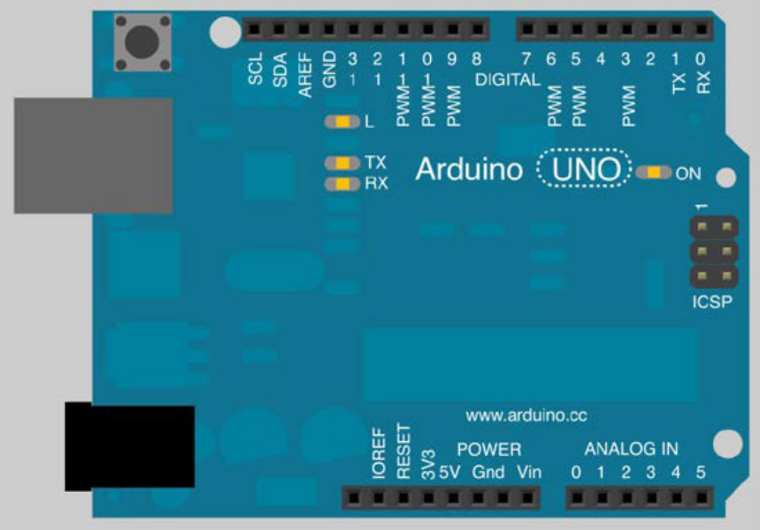
Check TX and RX on digital pins 1 and 0.
Arduino IDE provides a nice serial monitor that displays all symbols sent by the board to the computer via the USB interface.
It provides a lot of baud rates from 300 baud to 115,200 baud.

Slide 66
Serial monitoring
Serial monitoring is the way of creating very basic and easy communication with our board! It means we can program it to speak to us, via the serial monitor.
If you have to debug something and the board's behavior differs from what you are expecting from it, and you want to "verify whether the problem stems from the firmware or not, you can create some routines that will write messages to you.
These messages are called traces.
Traces can be totally necessary for debugging source code.

Slide 67
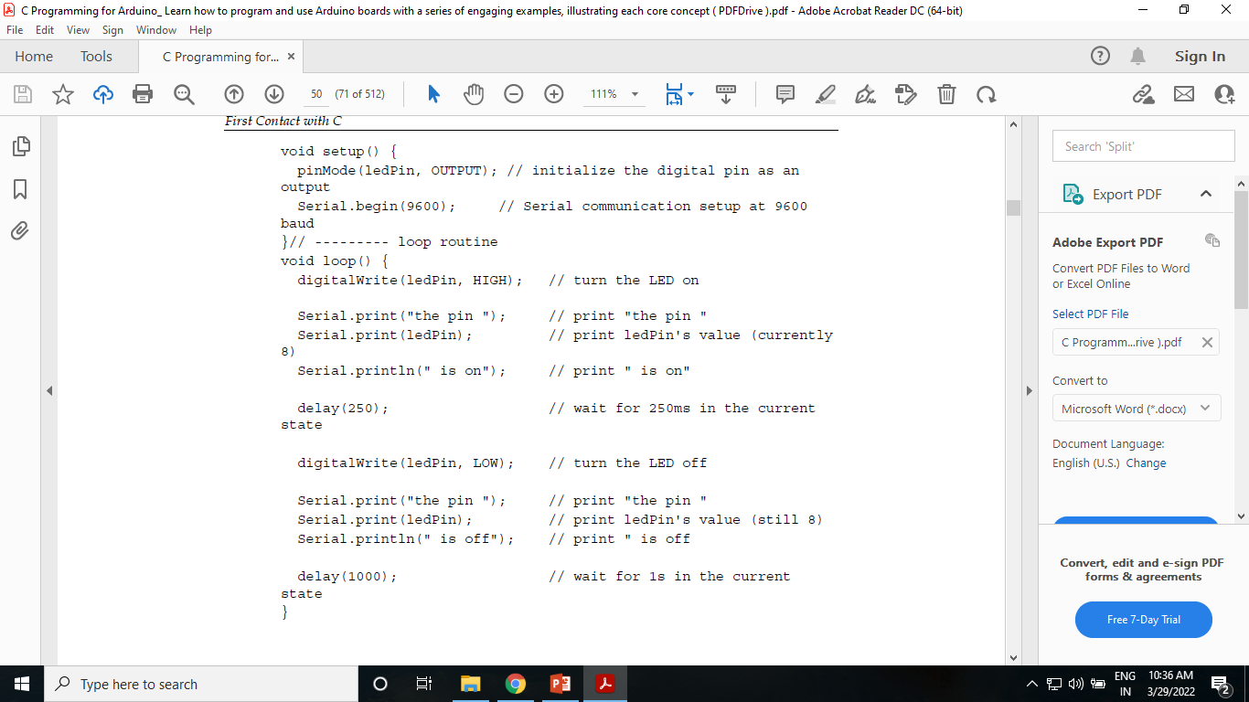
Adding serial communication to Blink250ms
Here, in the following code, we'll add serial communication for the LED to blink every 250 ms:
// Pin 8 is the one connected to our pretty LED
int ledPin = 8; // ledPin is an integer variable initialized at 8
// --------- setup routine

Slide 68

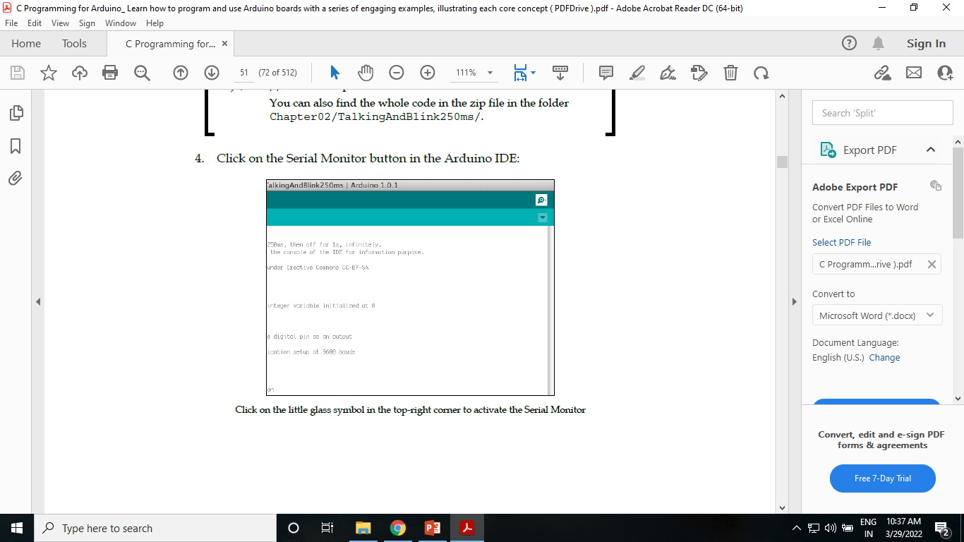

Slide 69
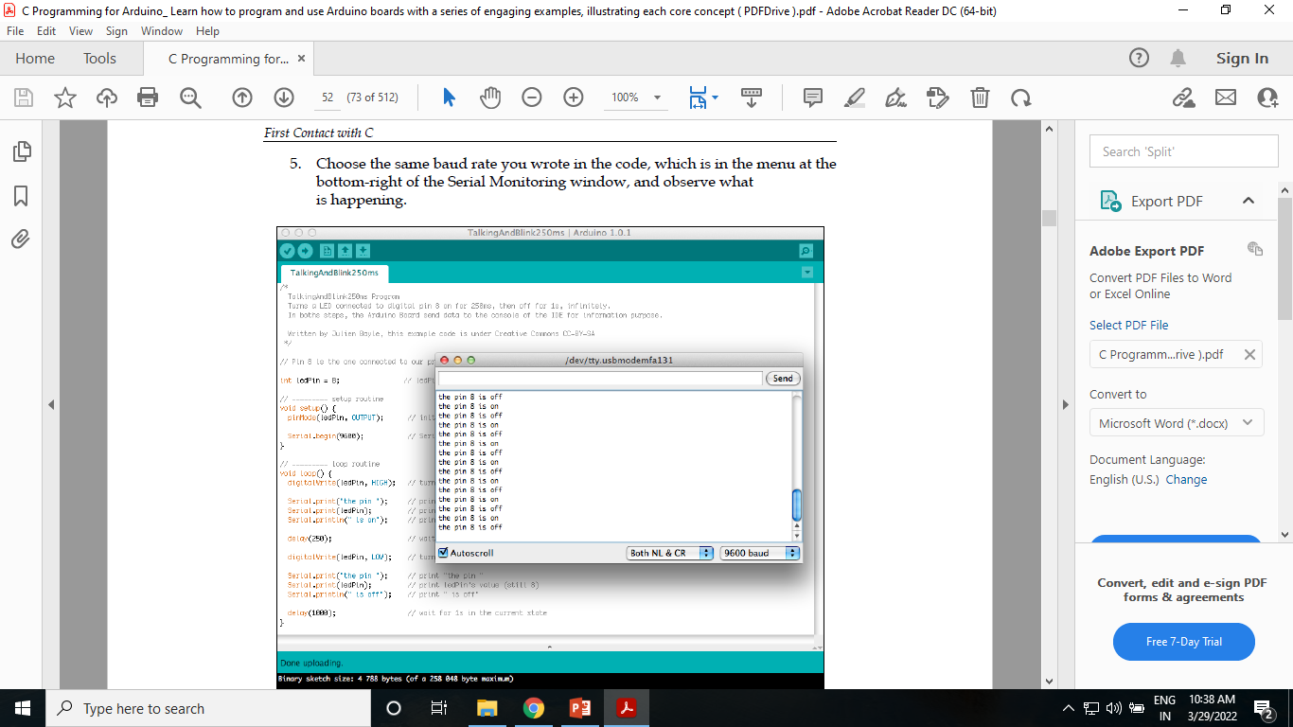

Slide 70
Serial functions in more detail
Serial.begin()
  Everything begins with the Serial.begin() function. This function in the setup() routine is executed only once, that is, when the Arduino is starting.
  In the code, I set up the board to initiate a serial communication at 9,600 baud.

Slide 71
Serial.print() and Serial.println()
  Serial.print() and Serial.println() behave almost identically: they write something to the serial output, but the ln version also adds a carriage return and a newline.
  The syntax of this function is Serial.print(val) or Serial.print(val,format).
  You can pass one or two arguments.
  Basically, if Serial.print(5) prints the number 5 as an ASCII-encoded decimal symbol, Serial.print(5,OCT) prints the number 5 as an ASCII-encoded octal one.

Slide 72
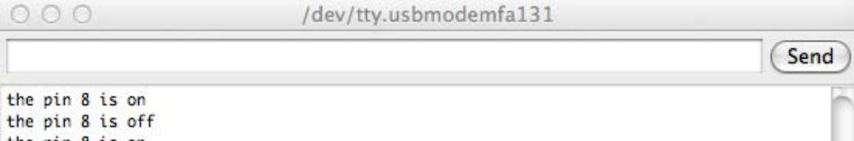
Talking to the board from the computer
You probably noticed a text field and a Send button in the Serial Monitor window:
This means we can also use that tool to send data to the board from our computer.
The firmware's board, however, has to implement some other functions in order to be able to understand what we'd like to send.

Slide 73
* Display "HELLO WORLD" string on serial monitor.
void setup() {
Serial.begin(9600); // set baud rate to 9600bps
Serial.println("HELLO WORLD"); //to get the message only once
}
void loop() {
//to print message infinite number of times
//Serial.println("HELLO WORLD");
}

Slide 74
Part B
Lab program 1
Write a Program to read 8-bit Boolean input from the serial monitor and display whether it has even or odd number of 1s and display the number of 1s in the input.

Slide 75
Sensing with Digital Inputs
Arduino boards have inputs and outputs.

Slide 76
Some types of sensors
  Temperature
  Humidity
  Pressure
  Gas sensors (gas-specific or not, smoke)
  Electromagnetic fields
  Anemometer (wind speed)
  Light
  Distance
  Capacitance
  Motion

Slide 77
Digital, in the computer and electronic worlds, means discrete, which is the opposite of analog/continuous

Slide 78
Inputs and outputs of Arduino
Arduino owns inputs and outputs. We can also distinguish analog and digital pins.
Arduino provides digital pins that can be both an input or an output
Arduino provides only analog input, not output
Inputs and outputs are pins provided by the board to communicate with external peripherals.

Slide 79
What is a button, a switch?
A switch is an electrical component that is able to break an electrical circuit.
Different types of switches
  Some switches are called toggles. Toggles are also named continuous switches. In order to act on the circuit, the toggle can be pushed and released each time you want to act and when you release it, the action continues.
  Some others are called momentaries. Momentaries are named push for action too. In order to act on the circuit, you have to push and keep the switch pushed to continue the action. If you release it, the action stops.

Slide 80
The pseudocode
Following are the steps we want our firmware to follow:
1. Define the pins.
2. Define a variable for the current switch state.
3. Set up the LED pin as an output.
4. Set up the switch pin as an input.
5. Set up an infinite loop. In the infinite loop do the following:
  1. Read the input state and store it.
  2. If the input state is HIGH, turn the LED ON.
  3. Else turn the LED OFF.

Slide 81
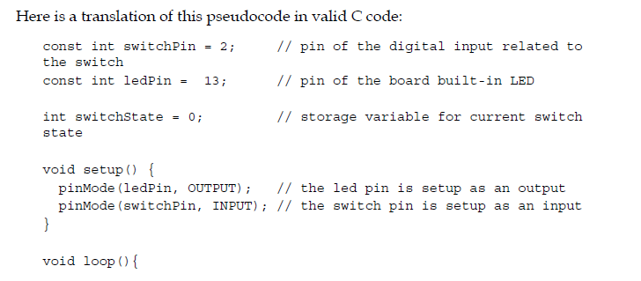
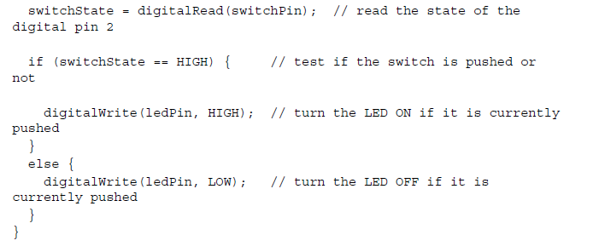
The code

Slide 82
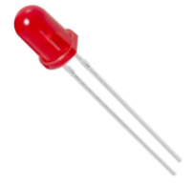
Light Emitting Diode (LED):
A LED is a semiconductor light source that emits light when the current flows through it.
Electrons in the semiconductor recombine with electron holes, releasing energy in the form of photons.
The colour of light is determined by the energy required for electrons to cross the band gap of the semiconductor.
The kit contains inbuilt LED.

Slide 83
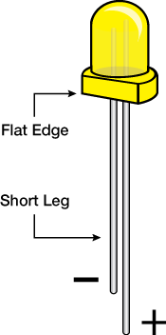
LED
To find out the polarity of an LED, look at it closely.
The shorter of the two legs, towards the flat edge of the bulb indicates the negative terminal.

Slide 84
Blinking of LED
In this experiment we have demonstrated blinking of LED, which is nothing but the continuous on and off of the LED.
The terminal of the LED is internal to the board so we can use the terminal by knowing the pin number. The pin number of the LED is digital pin 13.
LED has 2 terminals one is connected to digital pin through resistor and another is connected to ground.

Slide 85
Code:
void setup() {
pinMode(13,OUTPUT); //Declare pin 13 as a output pin
}
void loop() {
digitalWrite(13,HIGH); // Set the LED pin to HIGH, so the LED will turn ON
delay(1000); // Give the delay of 1 second
digitalWrite(13,LOW); // Set the LED pin to LOW, so the LED will turn OFF
delay(1000); // Give the delay of 1 second
}

Slide 86
Controlling the brightness of the LED using Potentiometer.
Potentiometer is a variable resistor
Resistor used is not a constant one it is a variable resistor known as POT.
If the resistance is more the brightness of LED is LOW and if the resistance is less the brightness of LED is HIGH.

Slide 87
Code
void setup() {
pinMode(13,OUTPUT); //Declare pin 13 as OUTPUT
digitalWrite(13, HIGH); // turn ON the LED. Now vary the potentiometer and see the brightness.
}
void loop() {
// No need to write anything here
}

Slide 88

Buzzer
A buzzer is an audio signalling device, which may be mechanical, electromechanical, or piezoelectric. In the board we have used piezoelectric buzzer. Typical uses of buzzers and beepers include alarm devices, timers, and confirmation of user input such as a mouse click or keystroke.

Slide 89
Turing on and off of Buzzer using switches
In this experiment we turn ON and OFF the Buzzer with the help of internal switches.
Switch_1 is connected with pin 14.
Switch_2 is connected with pin 15.
LED is connected with pin 13.
If switch_1 is pressed the Buzzer will turn ON.
IF switch_2 is pressed the Buzzer will turn OFF.

Slide 90
Code:
#define switch_1 14 // digital pin 14 is connceted with switch_1
#define switch_2 15 // digital pin 15 is connected with switch_2
#define Buzzer 16 // digital pin 13 is connected with Buzzer
void setup() {
pinMode(Buzzer,OUTPUT); //Configure LED as output
pinMode(switch_1,INPUT); //Configure switch_1 as input
pinMode(switch_2,INPUT); //Configure switch_2 as input
}
void loop() {
if (digitalRead(switch_1) == LOW && digitalRead(switch_2) == HIGH){ // if the switch_1 is pressed
digitalWrite(Buzzer,HIGH); //Turn ON LED
}
if (digitalRead(switch_1) == HIGH && digitalRead(switch_2) == LOW){ // if the switch_2 is pressed
digitalWrite(Buzzer,LOW); //Turn OFF LED
}
delay(500);
}

Slide 91
Lab Experiment 2
Write a Program
To control the brightness of LED using the potentiometer.
To turn buzzer ON/OFF using switches.

Slide 92
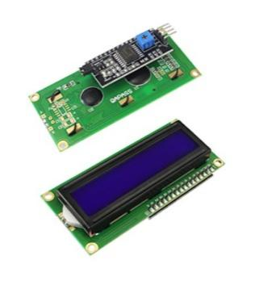
LCD along I2C module
An LCD is an electronic display module which uses liquid crystal to produce a visible image. The 16×2 LCD display is a very basic module commonly used in DIYs and circuits. The 16×2 translates a display 16 characters per line in 2 such lines. In this LCD each character is displayed in a 5×7pixel matrix.
The I2C or IIC stands for “Inter-Integrated Circuit” is a serial computer bus invented by Philips semiconductors, today known as NXP semiconductors. The main advantage of I2C bus protocol is that, the supported microcontroller or sensors or chips can be interlinked with just two wires. The two wires are SDA and SCL which are Serial Data and Serial clock respectively. The Serial clock or SCL is used to sync the data communication over I2C bus. The SDA or Serial Data is the data line in which the actual data is conveyed from master to slave and vice versa.

Slide 93
Display a string on LCD.
In this experiment a string is displayed on LCD.
Since 16x2 LCD has so many pins, the I2C module is used to reduce the pins used.
Before compiling this sketch LiquidCrystal_I2C.h library should be installed

Slide 94
Code
#include <LiquidCrystal_I2C.h> // include the library
LiquidCrystal_I2C lcd(0x27,16,2); // Initialize LCD pins
void setup() {
lcd.init(); // Initializing LCD
lcd.setCursor(0,0); // Set the cursor to the first position
lcd.print(“NMAMIT");
lcd.setCursor(0,1);
lcd.print(“NITTE");
}
void loop() {
// Nothing required to write
}

Slide 95
Exp 3
Write a Program
  To display two messages two messages alternatively with flickering effect on LCD for a suitable period of time.
  To display a message using scrolling effect on LCD for a suitable period of time.

Slide 96
To display two messages two messages alternatively with flickering effect on LCD for a suitable period of time.

Slide 97
To display a message using scrolling effect on LCD for a suitable period of time.

Slide 98
7-segment display
There are two types of LED 7-segment display; they are Common Cathode (CC) and Common Anode (CA) 7-segment.
Common cathode 7-segment display is used in TM1637 module.
The 7-segment display has 7 led’s for displaying the alphanumeric characters and also has an extra LED to display fractional point.
But the TM1637 module doesn’t have the fractional point. Since the type of 7-segment used is Common Cathode, all the cathodes of 7 led’s made common and it is connected to ground.
To turn on the led the anode pin is made HIGH i.e. ‘1’. To display numerical characters we can just use a library.
But to display alphabetic characters the below hexadecimal representation is used.

Slide 99
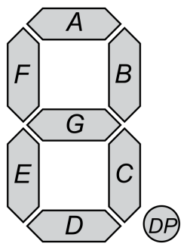
Digit | 7-segments |  |  |  |  |  |  | Hexadecimal Representation
 | g | f | e | d | c | b | a
a | 1 | 0 | 1 | 1 | 1 | 1 | 1 | 0x5F
b | 1 | 1 | 1 | 1 | 1 | 0 | 0 | 0x7C
C | 0 | 1 | 1 | 1 | 0 | 0 | 1 | 0x39
d | 1 | 0 | 1 | 1 | 1 | 1 | 0 | 0x5E
E | 1 | 1 | 1 | 1 | 0 | 0 | 1 | 0x79
F | 1 | 1 | 1 | 0 | 0 | 0 | 1 | 0x71
G | 1 | 1 | 1 | 1 | 1 | 0 | 1 | 0x7D
H | 1 | 1 | 1 | 0 | 1 | 1 | 0 | 0x76
I | 0 | 0 | 0 | 0 | 1 | 1 | 0 | 0x06
J | 0 | 0 | 0 | 1 | 1 | 1 | 0 | 0x0E
L | 0 | 1 | 1 | 1 | 0 | 0 | 0 | 0x38
n | 1 | 0 | 1 | 0 | 1 | 0 | 0 | 0x54
o | 1 | 0 | 1 | 1 | 1 | 0 | 0 | 0x5C
P | 1 | 1 | 1 | 0 | 0 | 1 | 1 | 0x73
q | 1 | 1 | 0 | 0 | 1 | 1 | 1 | 0x67
R | 1 | 1 | 1 | 0 | 1 | 1 | 1 | 0x77
S | 1 | 1 | 0 | 1 | 1 | 0 | 1 | 0x6D
t | 1 | 1 | 1 | 1 | 0 | 0 | 0 | 0x78
U | 0 | 1 | 1 | 1 | 1 | 1 | 0 | 0x3E
y | 1 | 1 | 0 | 1 | 1 | 1 | 0 | 0x6E

Slide 100
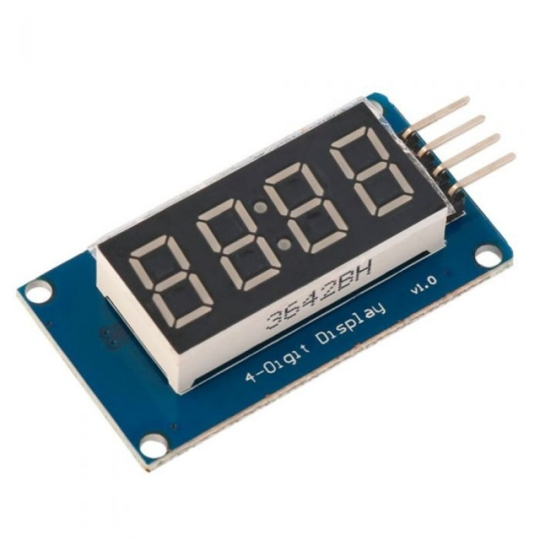
In this kit we have used TM1637 display as shown below. It is a kind of LED (light-emitting diode display) drive control special circuit with keyboard scan interface and it's internally integrated with MCU digital interface, data latch, LED high pressure drive and keyboard scan. This product is in DIP20/SOP20 package type with excellent performance and high quality, which is mainly applicable to the display drive of induction cooker, micro-wave oven and small household electrical appliance.
This module has 4 pins in which 2 are power pins and another 2 pins are connected to digital pins. Since this was internally connected to digital pins of microcontroller.

Slide 101
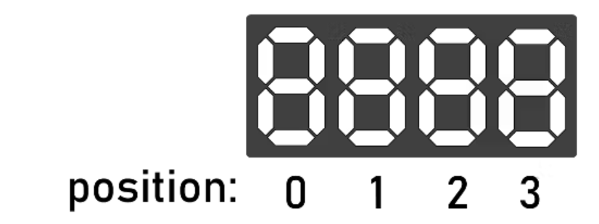
To set the brightness, pass in a value between 0-7 into tm.set();
you can display characters in the loop function with 2 methods:
tm.display(<position>, <character> ); will display a character on the display.
Position refers to the digit you want to change. The first is 0 and the last is 3

Slide 102
Character refers to the character you want to display. 0-9 displays 0-9 and 10-15 displays A-F
setSegments() – Set the raw value of the segments of each digit
showNumberDec() – Display a decimal number
showNumberDecEx() – Display a decimal number with decimal points or colon
setBrightness() – Set the brightness of the display
clear() – Clear the display

Slide 103
Syntax: showNumberDec(number, leading_zeros, length, position)
This is probably the function that you will use the most. The first argument is a number that you want to display on the screen. The rest of the arguments are optional.
The second argument can be used to turn on or off leading zeros. 10 without leading zeros would print as __10 and with leading zeros as 0010. You can turn them on by setting this argument as true or turn them off by setting it as false. NOTE: leading zero is not supported with negative numbers.

Slide 104
Display 4-digit number on 7-segment display.
#include <TM1637.h>
int CLK = 8;
int DIO = 9;
TM1637 tm(CLK,DIO);
void setup() {
// Initialize 7-segment display
tm.init();
//set brightness; 0-7
tm.set(2);
}
void loop() {
// example: "1234"
displayNumber(1234);
delay(1000); //delay of 1 second
}
void displayNumber(int num){
tm.display(0, num / 1000 % 10); // condition to get 1st digit from the given number
from the given number
Tm.display(1, num/100%10)
tm.display(2, num / 10 % 10); // condition to get 3rd digit from the given number
tm.display(3, num % 10); // condition to get 4th digit from the given number
}

Slide 105
Exp 4
Write a Program to perform up-down counter on a 7-segment display using switches.
  In this experiment we perform up and down counter with the help of switches.
  When switch_1 is pressed the counter starts incrementing.
  When switch_2 is pressed the counter starts decrementing.

Slide 106
Exp 5
Write a Program to perform ring counter on a 7-segment display.

Slide 107
Stepper motor
A Stepper Motor or a step motor is a brushless, synchronous motor, which divides a full rotation into a number of steps. Unlike a brushless DC motor, which rotates continuously when a fixed DC voltage is applied to it, a step motor rotates in discrete step angles.
The shaft of a stepper, mounted with a series of magnets, is controlled by a series of electromagnetic coils that are charged positively and negatively in a specific sequence, precisely moving it forward or backward in small "steps".
The Stepper Motors therefore are manufactured with steps per revolution of 12, 24, 72, 144, 180, and 200, resulting in stepping angles of 30, 15, 5, 2.5, 2, and 1.8 degrees per step. The stepper motor can be controlled with or without feedback.

Slide 108
Imagine a motor on an RC airplane. The motor spins very fast in one direction or another. You can vary the speed with the amount of power given to the motor, but you cannot tell the propeller to stop at a specific position.
Now imagine a printer. There are lots of moving parts inside a printer, including motors. One such motor acts as the paper feed, spinning rollers that move the piece of paper as ink is being printed on it. This motor needs to be able to move the paper an exact distance to be able to print the next line of text or the next line of an image.
There is another motor attached to a threaded rod that moves the print head back and forth. Again, that threaded rod needs to be moved an exact amount to print one letter after another. This is where the stepper motors come in handy.

Slide 109
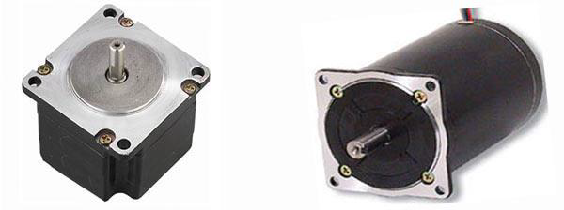

Slide 110
How a Stepper Motor Works?
A regular DC motor spins in only direction whereas a Stepper motor can spin in precise increments.
Stepper motors can turn an exact amount of degrees (or steps) as desired. This gives you total control over the motor, allowing you to move it to an exact location and hold that position. It does so by powering the coils inside the motor for very short periods of time. The disadvantage is that you have to power the motor all the time to keep it in the position that you desire.
All you need to know for now is that, to move a stepper motor, you tell it to move a certain number of steps in one direction or the other, and tell it the speed at which to step in that direction.

Slide 111
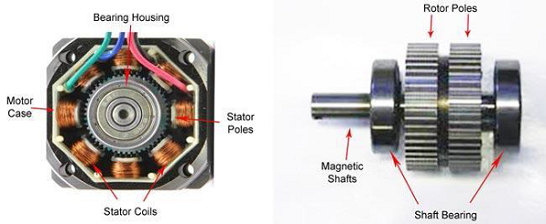

Slide 112
Example
Drive a stepper motor for clockwise direction by N steps.
const int dirPin = 2;
const int stepPin = 3;
const int stepsPerRevolution = 10;
void setup()
{
// Declare pins as Outputs
pinMode(dirPin, OUTPUT);
pinMode(stepPin, OUTPUT);
// Set motor direction clockwise
digitalWrite(dirPin, HIGH);
for(int x = 0; x < stepsPerRevolution; x++)
{
digitalWrite(stepPin, HIGH);
delay(1000);//wait for 1 second
digitalWrite(stepPin, LOW);
delay(1000);//wait for 1second
}
}
void loop()
{
//No need to write here
}

Slide 113
Exp 6
Write a Program to control the speed of rotation of a stepper motor using potentiometer.

Slide 114
Exp 7
Write a Program to drive a stepper motor clockwise and anticlockwise with the help of switches

Slide 115
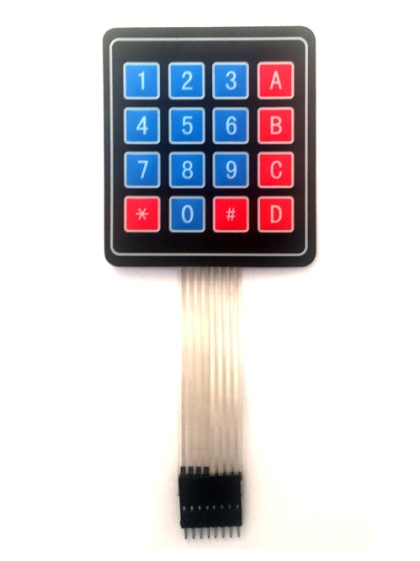
Keypad
A 4x4 keypad will have eight terminals. In them four are rows of matrix and four are columns of matrix. It has 16 built-in pushbutton contacts connected to row and column lines.
A microcontroller can scan these lines for a button-pressed state. In the keypad library, the Propeller sets all the column lines to input, and all the row lines to input.
Then, it picks a row and sets it high. After that, it checks the column lines one at a time. If the column connection stays low, the button on the row has not been pressed.
If it goes high, the microcontroller knows which row and which column.

Slide 116
Example
Displaying characters on serial monitor using keypad.
#include <Keypad.h> // include the keypad library
const byte ROWS = 4; //four rows
const byte COLS = 4; //four columns
//define the cymbols on the buttons of the keypads
char hexaKeys[ROWS][COLS] = {
{'1','2','3','A'},
{'4','5','6','B'},
{'7','8','9','C'},
{'*','0','#','D'}
};
byte rowPins[ROWS] = {22, 23, 24, 25}; //connect to the row pinouts of the keypad
byte colPins[COLS] = {26, 27, 28, 29}; //connect to the column pinouts of the keypad
//initialize an instance of class NewKeypad
Keypad customKeypad = Keypad( makeKeymap(hexaKeys), rowPins, colPins, ROWS, COLS);

Slide 117
void setup(){
Serial.begin(9600);
}
void loop(){
char customKey = customKeypad.getKey(); // Variable used to store the key pressed by the user
if (customKey){
Serial.println(customKey);
}
}

Slide 118
Exp 8
Write a Program to read the input from 4x4 keypad and simulate operations as a calculator

Slide 119
Thank You…

